Slide 1
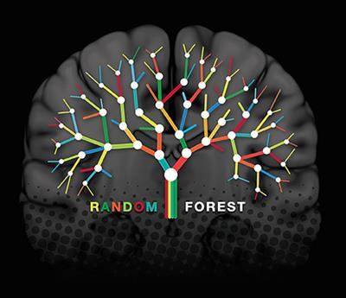
Random Forest Algorithm
By Deepak Kaura

Slide 2
Table of contents
Definition of Random Forest Algorithm
Diagram
Advantages
Disadvantages
Difference Between Random Forest and Decision Tree
Real-life example of Random Forest
Working of Random Forest Algorithm
Random Forest Algorithm applications
One Practical example

Slide 3
Definition
The random forest uses many trees, and it makes a prediction by averaging the predictions of each component tree.
As the name suggests, this algorithm creates the forest with a number of trees.
The final decision is made based on the majority of the trees and is chosen by the random forest.
Random forest algorithm can be used for both classifications and regression task.

Slide 4
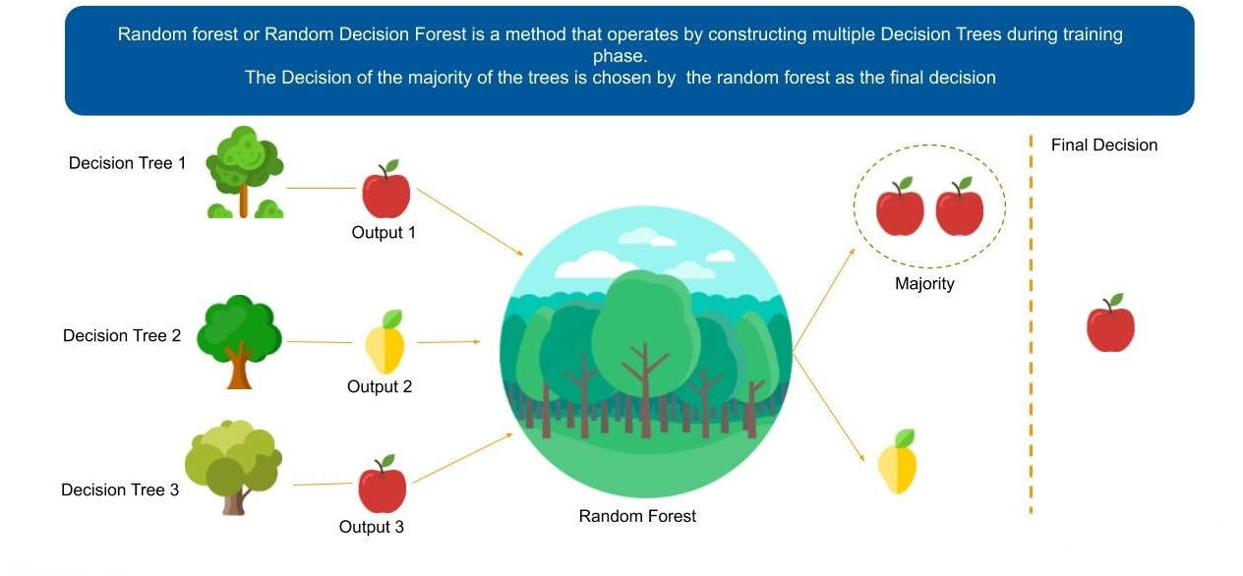
Diagram of Random Forest

Slide 5
Advantages of Random Forest
It reduces overfitting in decision trees and helps to improve the accuracy.
It automates missing values present in the data.
It works well with both categorical and continuous variables.
It is very stable. Even if a new data point is introduced in the dataset, the overall algorithm is not affected much since the new data may impact one tree, but it is very hard for it to impact all the trees.

Slide 6
Disadvantages of Random Forests
It requires much computational power as well as resources as it builds numerous trees to combine their outputs.
It also requires much time for training as it combines a lot of decision trees to determine the class.
A forest is less interpretable than a single decision tree. Single trees may be visualized as a sequence of decisions.

Slide 7
Difference Between
Random Forest | Decision Tree
Comparatively more complex | Simpler and easier to understand, interpret and visualize
2) Gives more accurate results | 2) Gives less accurate results
3) Reduced risk of overfitting | 3) There is a possibility of overfitting
An ensemble learning method that operates by constructing a multitude of decision trees at training time and outputting the class depending on the individual trees | A decision support tool that uses a tree-like graph or model of decisions and their possible, consequences, including chance event outcomes, resource cost, and utility.

Slide 8
Random forest algorithm real-life example
Let suppose there is a man and his name is Mady somehow got 2 weeks’ leave from his office. He wants to spend his 2 weeks traveling to a different place. He also wants to go to the place he may like.
So he decided to ask his best friend about the places he may like. Then his friend started asking about his past trips. It’s just like his best friend will ask, You have been visited the X place did you like it?
Based on the answers which are given by Mady, his best start recommending the place Mady may like. Here his best formed the decision tree with the answer given by Mady.
As his best friend may recommend his best place to Mady as a friend. The model will be biased with the closeness of their friendship. So he decided to ask a few more friends to recommend the best place he may like.
Now his friends asked some random questions and each one recommended one place to Mady. Now Mady considered the place which is high votes from his friends as the final place to visit.
In the above Mady trip planning, two main interesting algorithms decision tree algorithm and random forest algorithm used. I hope you find it already. Anyhow, I would like to highlight it again.

Slide 9
Working of Random Forest Algorithm
Let us understand the working of Random Forest algorithm with the help of following steps −
First, start with the selection of random samples from a given dataset.
Next, this algorithm will construct a decision tree for every sample. Then it will get the prediction result from every decision tree.
In this step, voting will be performed for every predicted result.
At last, select the most voted prediction result as the final prediction result.

Slide 10
Random forest algorithm applications
Below are some the applications where the random forest algorithm is widely used : -
Medicine - In the medicine field, a random forest algorithm is used to identify the correct combination of the components to validate the medicine. Random forest algorithm also helpful for identifying the disease by analyzing the patient’s medical records.
Stock Market - In the stock market, a random forest algorithm used to identify the stock behavior as well as the expected loss or profit by purchasing the particular stock.
E-commerce - In e-commerce, the random forest used only in the small segment of the recommendation engine for identifying the likely hood of customers liking the recommend products base on similar kinds of customers.
Banking - In the banking sector, a random forest algorithm widely used in two main applications. These are for finding loyal customers and finding fraud customers.
continue…….

Slide 11
Continue……….
Banking - In the banking sector, a random forest algorithm widely used in two main applications. These are for finding loyal customers and finding fraud customers.
The loyal customer means not the customer who pays well, but also the customer who can take the huge amount as loan and pays the loan interest properly to the bank.
In the same way, there is a need to identify the customer who is not profitable for the bank, like taking the loan and paying the loan interest properly or find outlier customers. If the bank can identify theses kind of customer before giving the loan the customer.

Slide 12
Practical Example
Click on the below link to see How Random Forest algorithm practically works : -

